Slide 1
EMBASSY OF EQUATORIAL GUINEA AT CALABAR, NIGERIA
CONSULTANTS:
PEE MOORE NIG LTD
Copy right 2013 All rights reserves

Slide 2
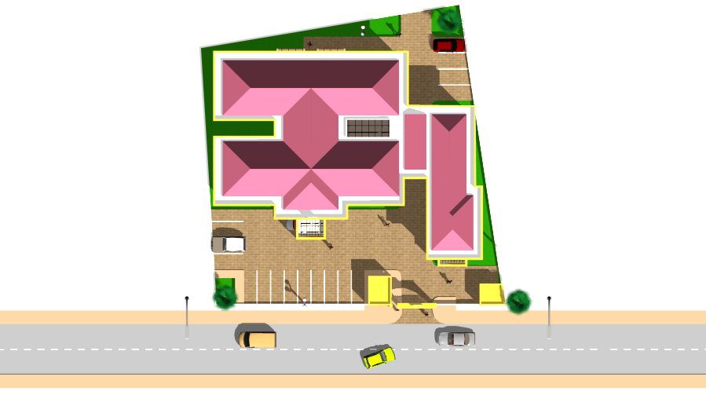

Slide 3
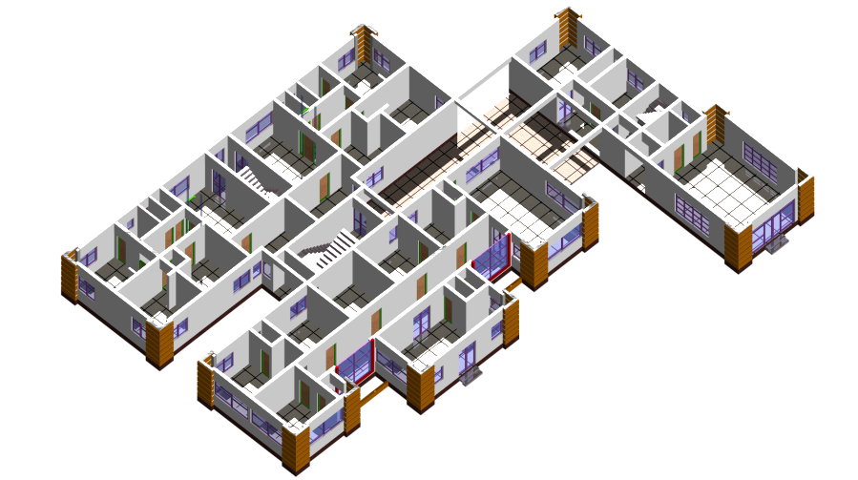

Slide 4
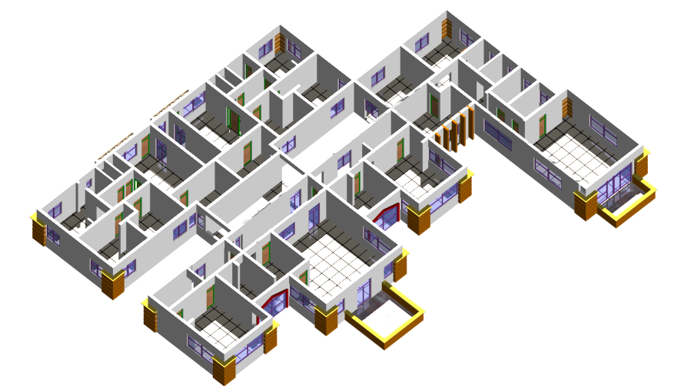

Slide 5


Slide 6


Slide 7


Slide 8
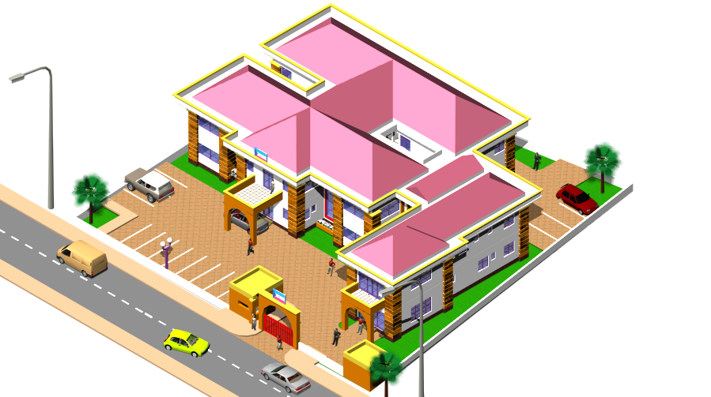

Slide 9
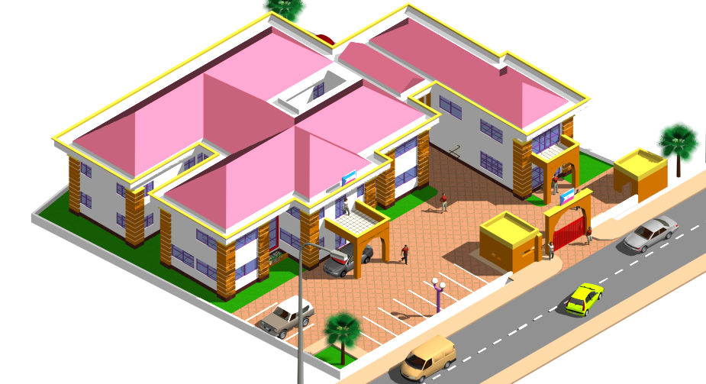

Slide 10
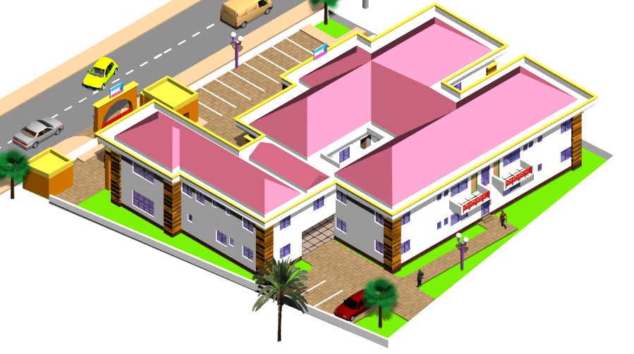

Slide 11
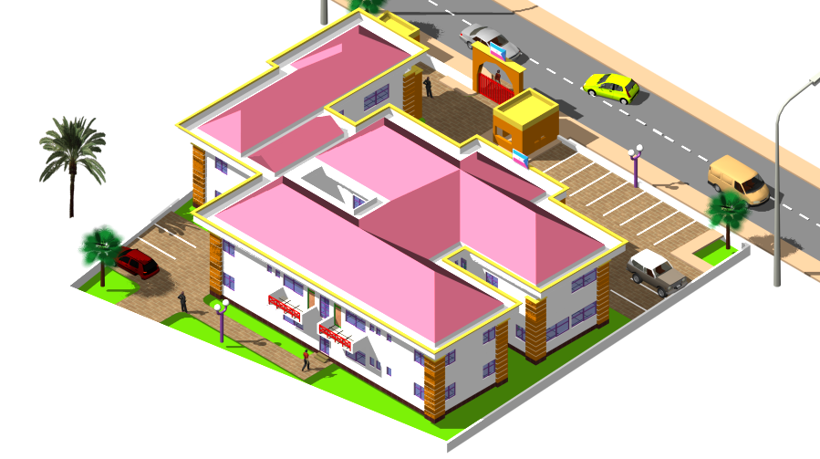

Slide 12
